Slide 1
Hotel Reservation
Project Presentation

Slide 2

Team Work
Name | Role
Aya Mohamed AbuElsoud | Front-End (Home, About +Responsive design) DataBase BackEnd
Ahmed GadElrab Abumusada | Front-End(Rooms)
Mohamed Khaled AbdElghany | Front-End (Services, Contact)

Slide 3
About the project
This project is a hotel website, the site includes the "Home" page that contains an overview of the hotel, the "About" page contains more information about the hotel and their awards and achievements that have achieved, a "Rooms" page that contains kinds of rooms in the hotel and their beautiful views, the "services" page contains all services for the guests and the activities for the kids And the "contact" page contains the registration methods for the hotel
Technologies used:
Front-End: HTML5, CSS3, JavaScript, Bootstrap, and jQuery
Back-End : MySQL, PHP & Laravel

Slide 4

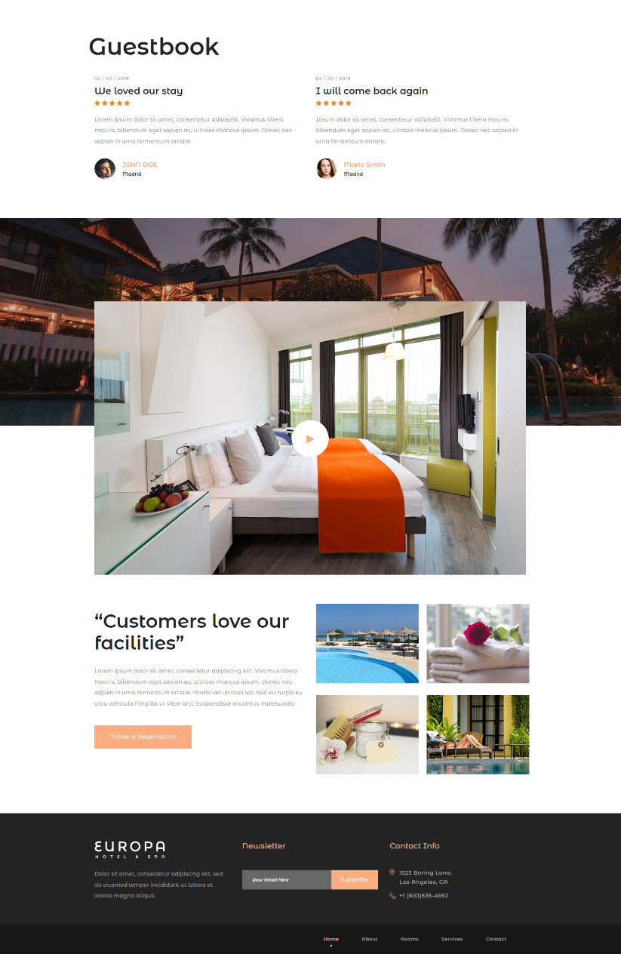
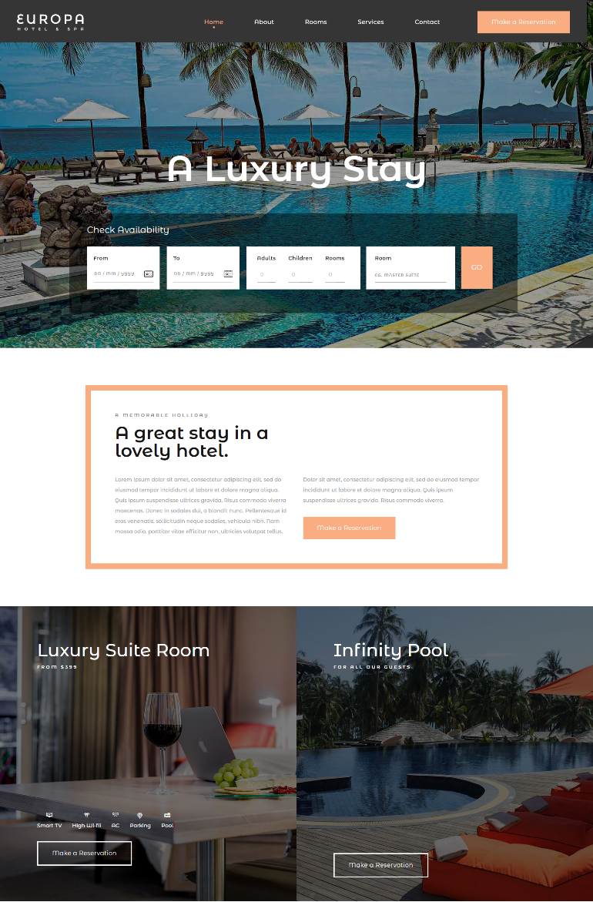
Front-end
Home Page
Top of the page

Slide 5
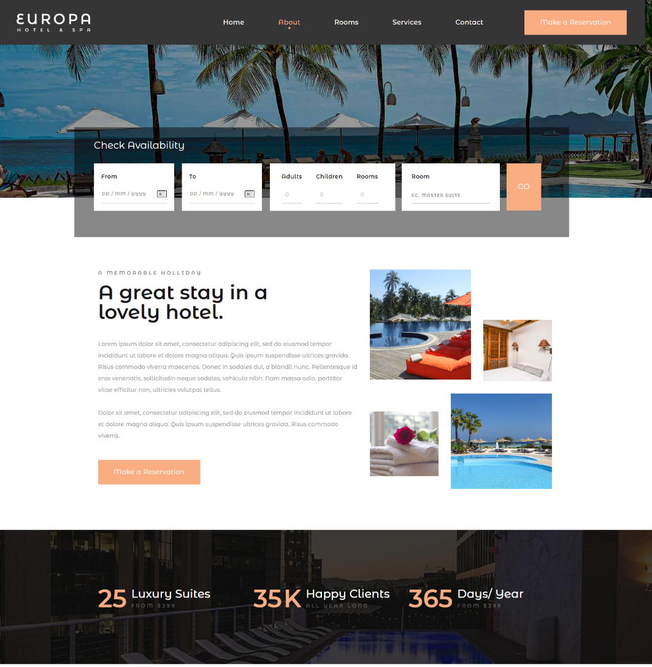

Front-end
About Page
Top of the page

Slide 6
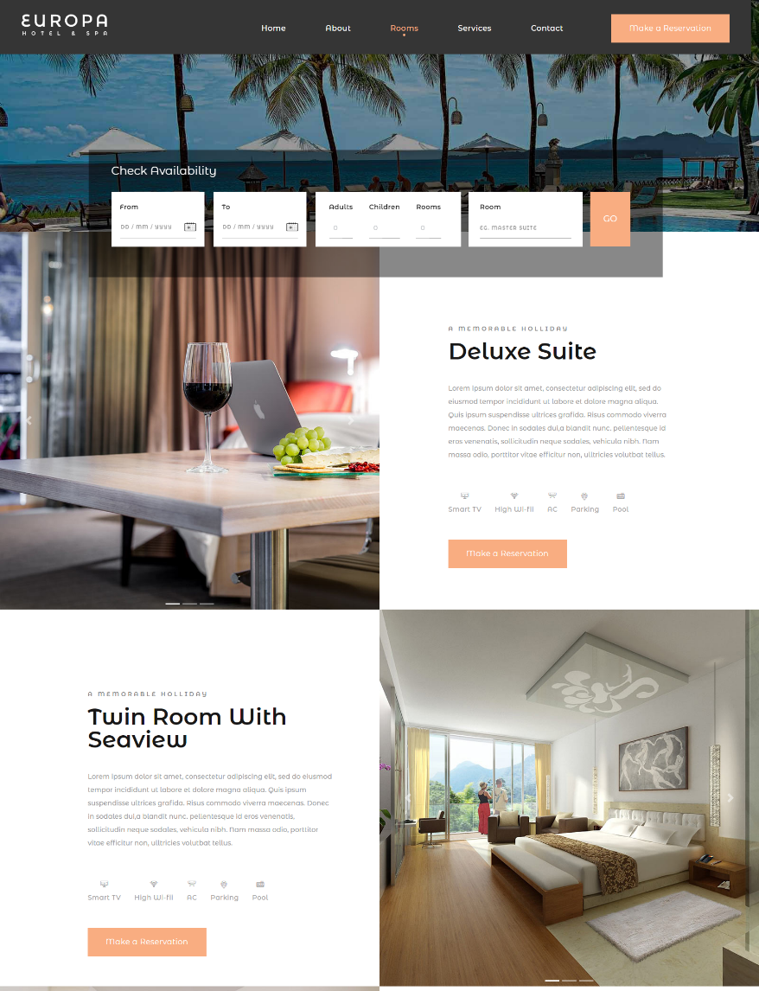
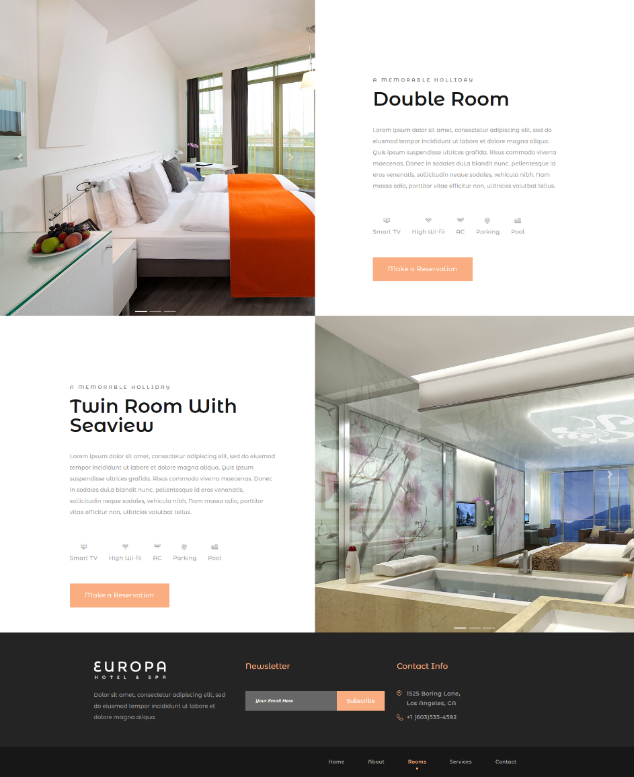
Front-end
Rooms Page
Top of the page

Slide 7
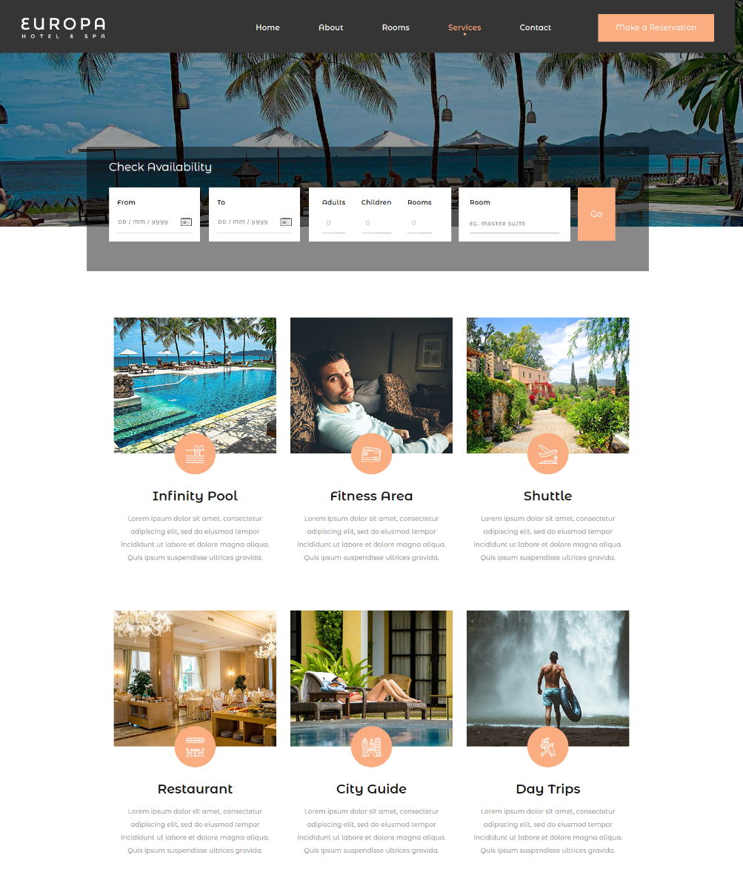
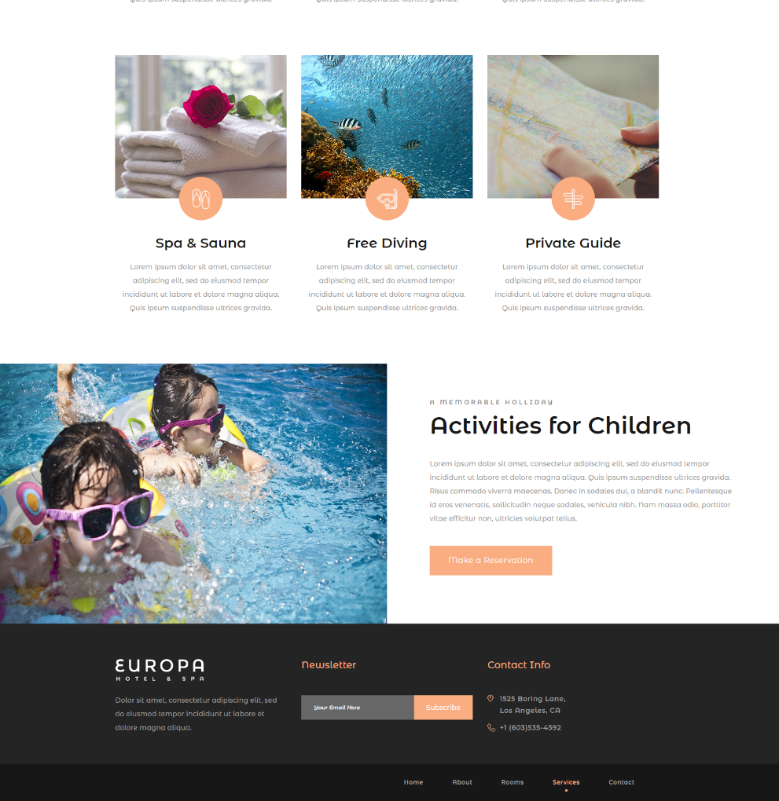
Front-end
Services Page
Top of the page

Slide 8
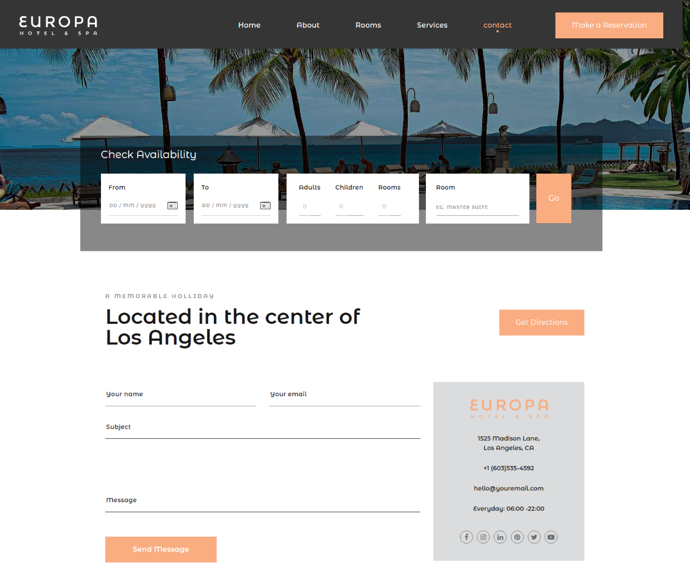
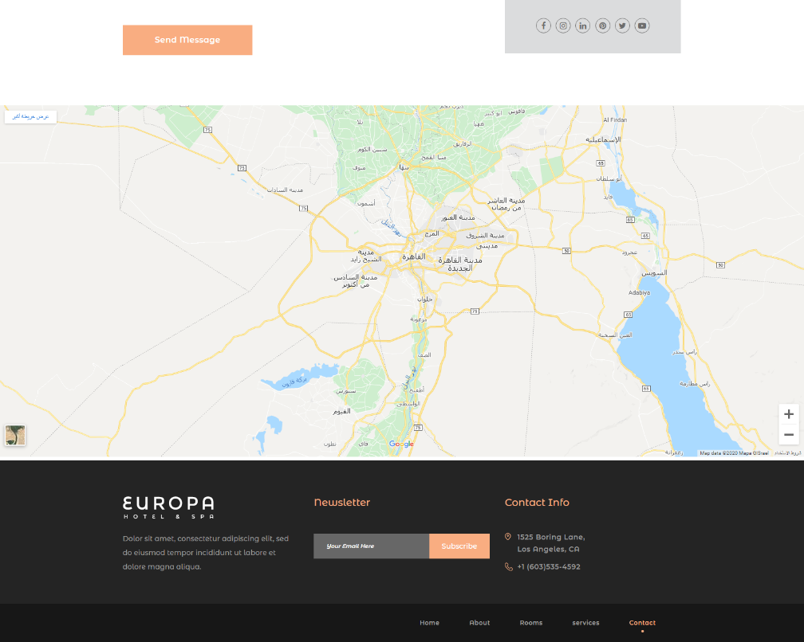
Front-end
Contact Page
Top of the page
Rest of the page

Slide 9
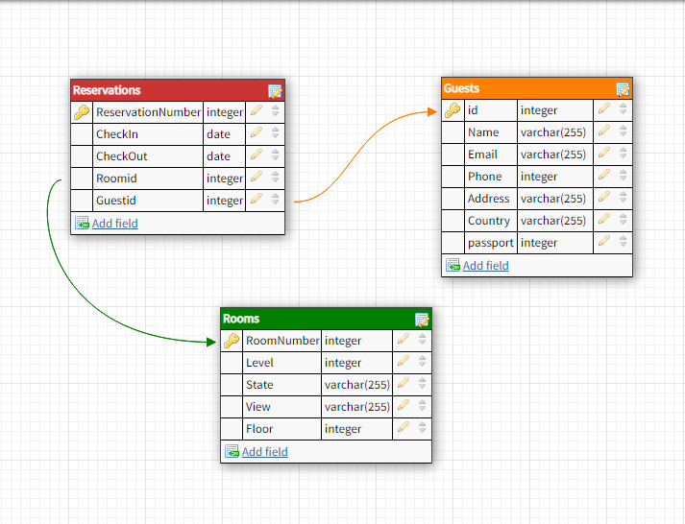
Data Base
Database design

Slide 10
Backend-end
This is the admin section that runs this site and manages the reservations from guests and available rooms
There are a" login" page, Then An "admin dashboard" page with the number of guests, reservations, the rooms, and the guests. And he can navigate to the pages of all of them by clicking on the object name from the button in the table or from the Navbar
Each page displays the details of reservations, rooms, and guests, and he can add, edit and delete any of them

Slide 11
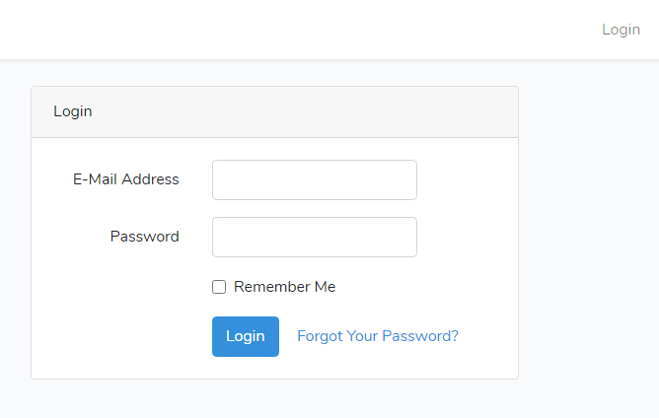
Back-end
Login page
Check by email: ayaabuelsoud98@gmail.com
Password: 12345678

Slide 12
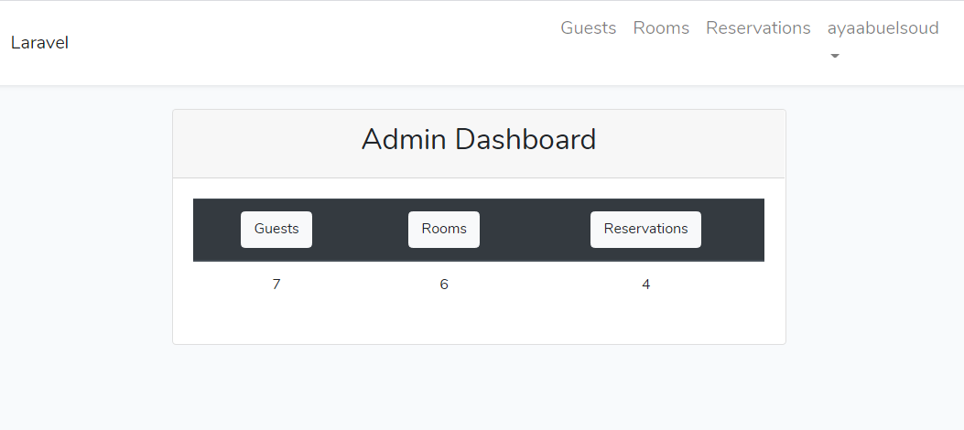
Back-end
Dashboard Page
Guests, Rooms and Reservation button you can navigate to the pages of all of them by clicking on the object name from the button in the table or from the Navbar

Slide 13
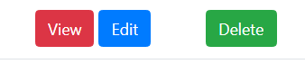
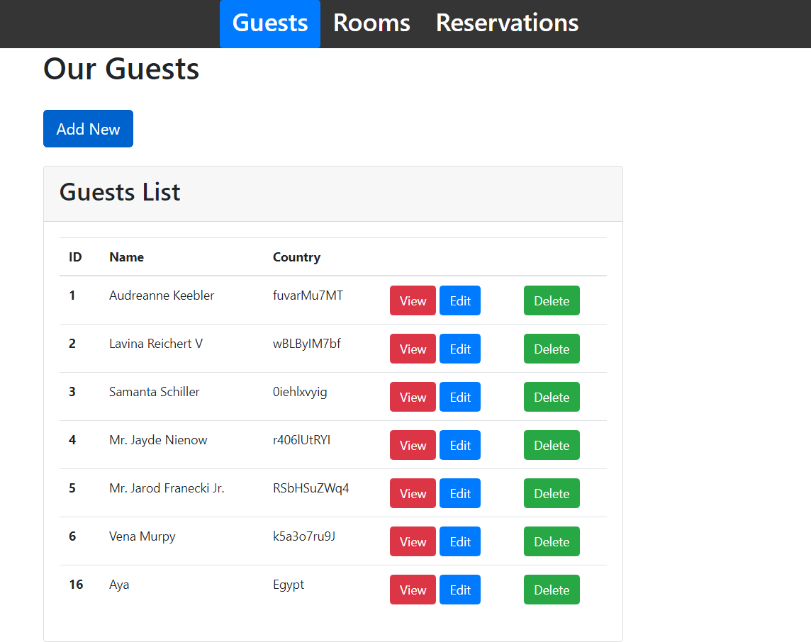
Back-end
Guests Page
All Guests and the function Create, View, Edit and Delete

Slide 14
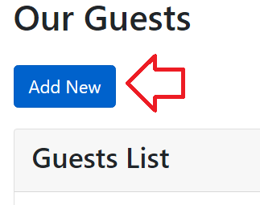
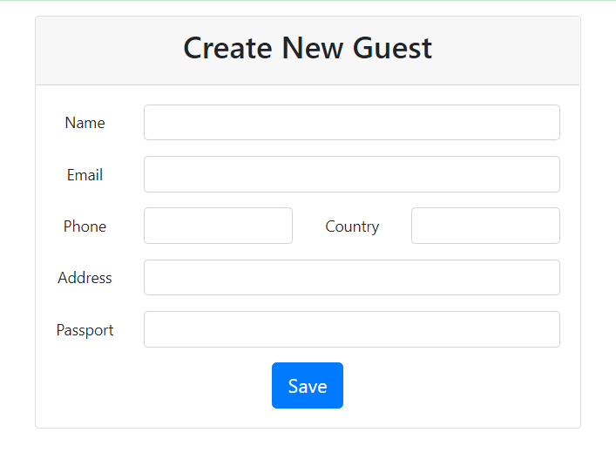
Back-end
Guests Page
Create Function

Slide 15

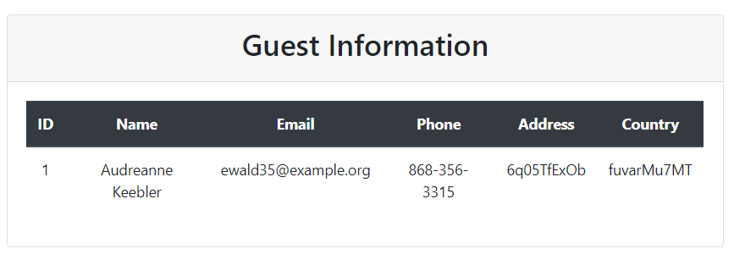
Back-end
Guests Page
View Function

Slide 16

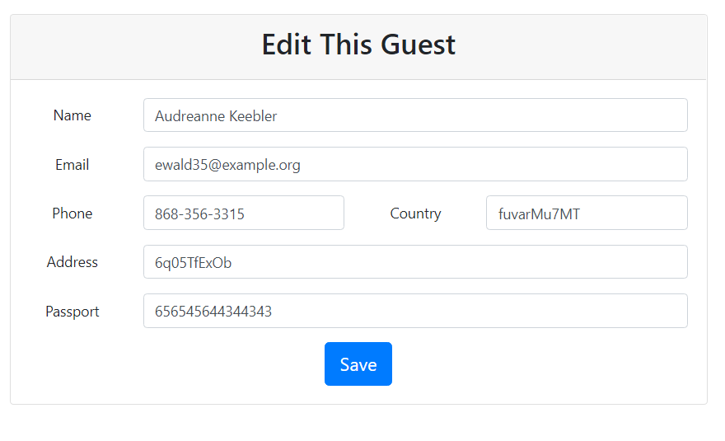
Back-end
Guests Page
Edit Function

Slide 17
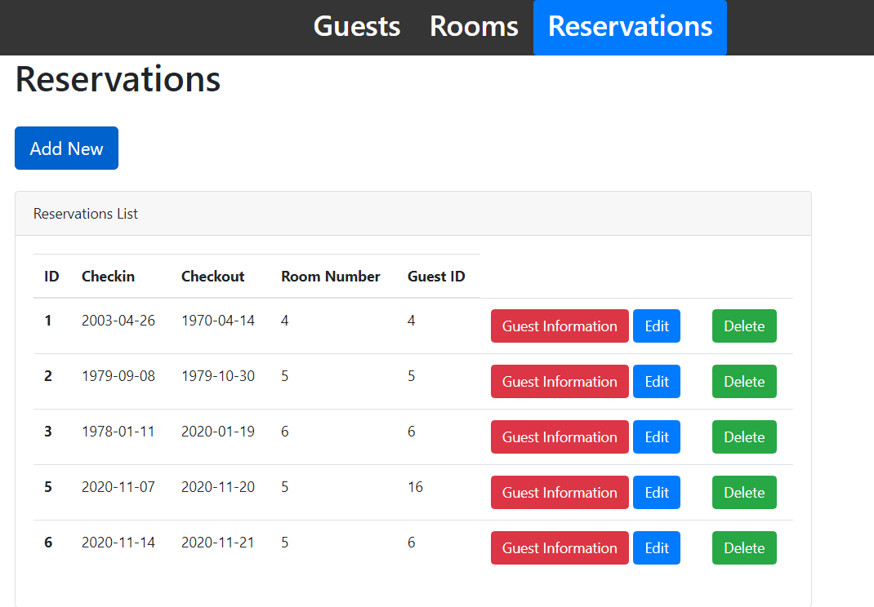
Back-end
Booking Page
All Reservations and the function Create, Guest Information, Edit and Delete

Slide 18
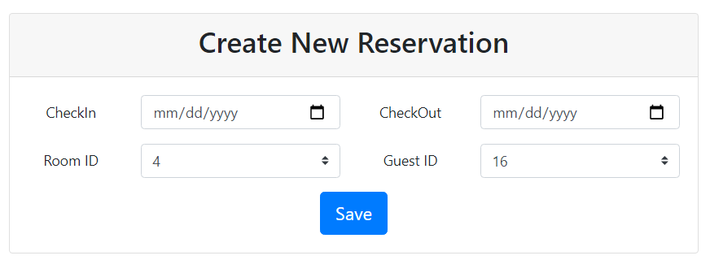
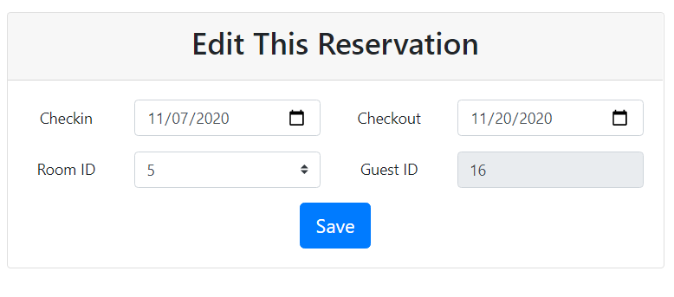
Back-end
Booking Page
Create Function
Edit Function

Slide 19
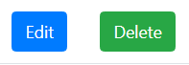
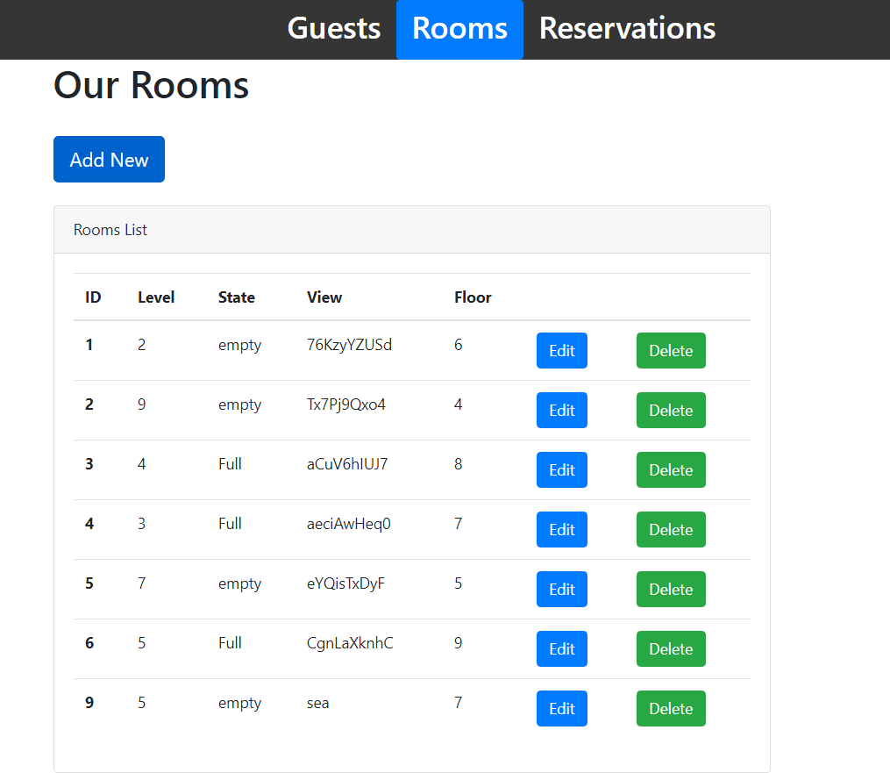
Back-end
Room Page
All Rooms and the function Create, Edit and Delete

Slide 20
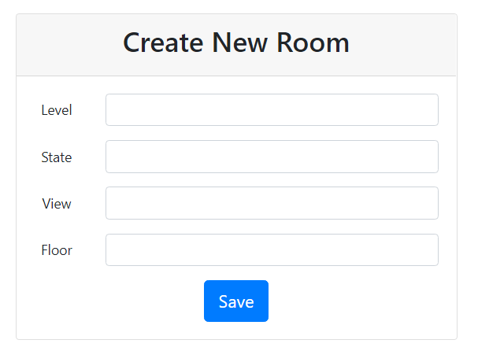
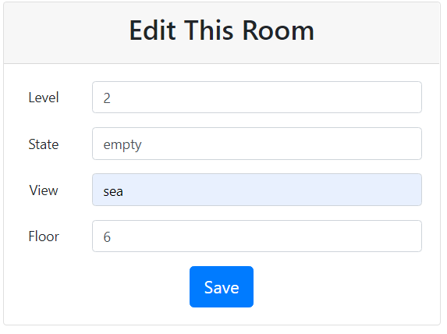
Back-end
Room Page
Create Function
Edit Function

